Slide 1
Company Information
²⁰¹⁸
Textron Motors - Company Confidential – Do Not Duplicate or Distribute
1

Slide 2

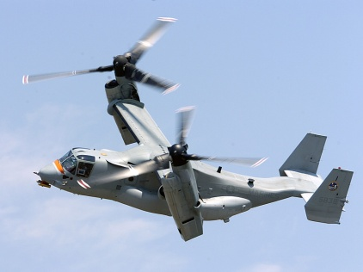
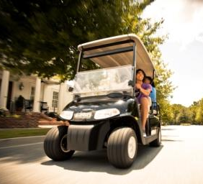









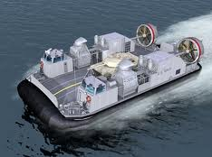


TEXTRON
Business Units
Industrial
  $13.9B Multi-Industry Company
  Over 35,000 Employees
  Operating in 25 Countries
Textron Motors - Company Confidential – Do Not Duplicate or Distribute
2

Slide 3
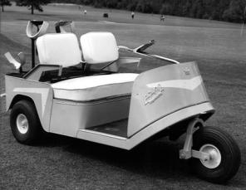
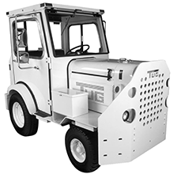
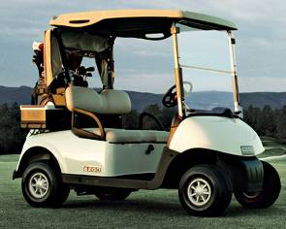
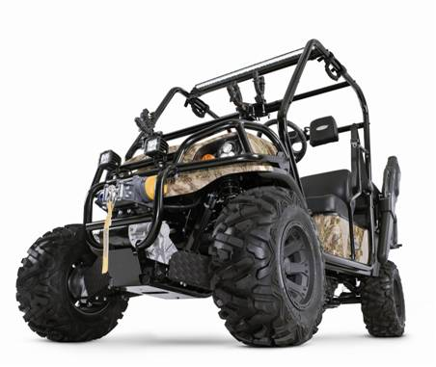
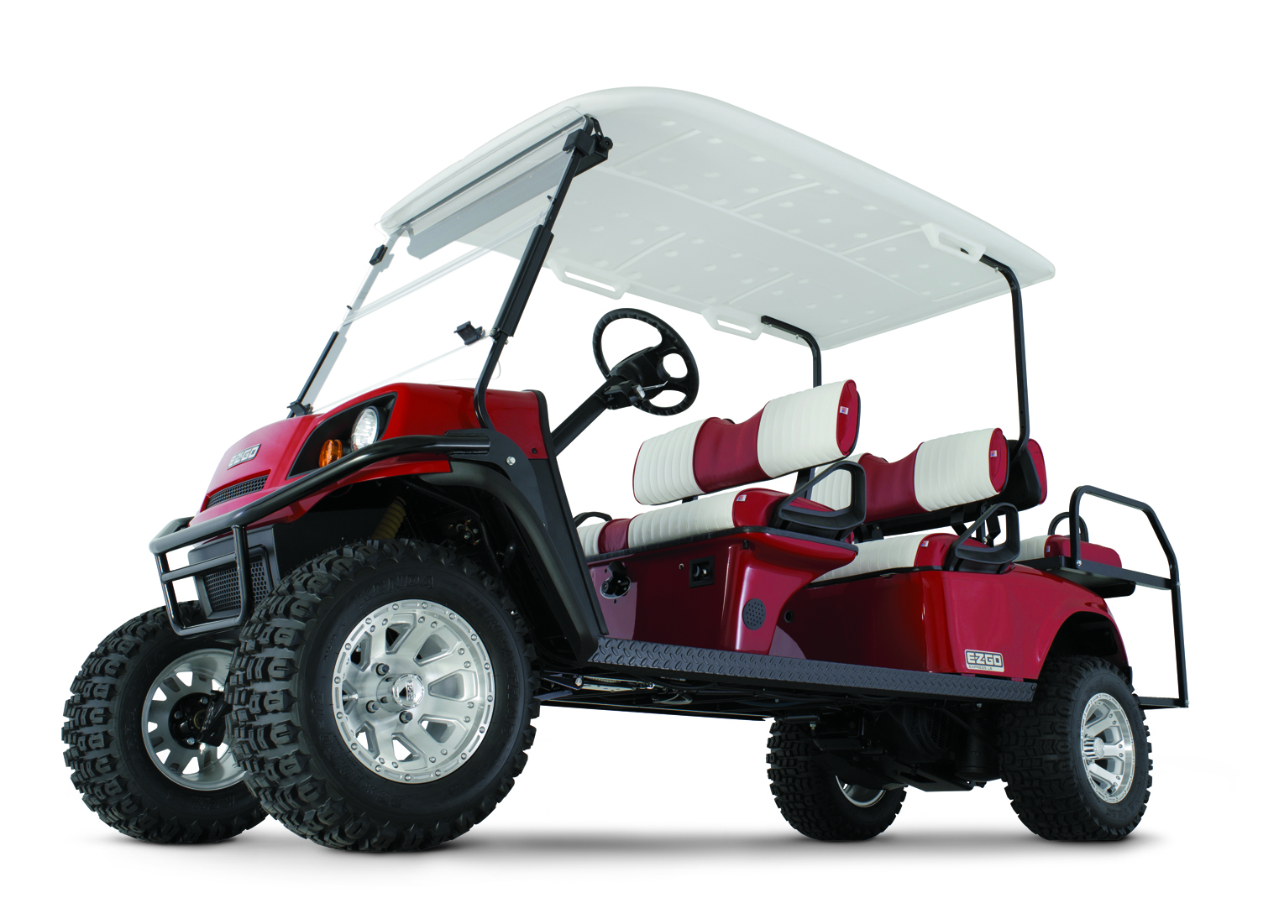
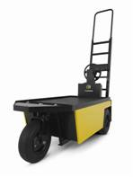
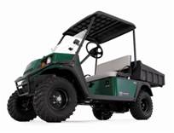
ABOUT TSV
TSV founded in Grovetown, GA in 1954
by brothers Beverly and Billy Dolan
Acquired by Textron in 1960
one of oldest businesses in Textron portfolio
Acquired Cushman in 1998
Acquired Bad Boy Buggies in 2010
Launched E-Z-GO Jiangsu 2012
(China joint venture)
Acquired TUG Technologies in 2014
Acquired Weber Motors in 2014,
Now Textron Motors
Notes:
By way of background – want to give a little insight to who we are and the great company we represent
EZGO celebrating diamond anniversary this year – 60 years from when our two founders Bev and Billy Dolan founded the company
Story of Augusta National – Autoette prototype – someones going to make a lot of money selling those products..company was born
After about 6-7 years – Textron purchased the company. Still owned today making us the 2nd oldest business in the portfolio
Bev stayed on with Textron ran Homelite, Polaris and ultimately became CEO, COB and President from 1980 to 1993. Acquired Cessna…
Company grown a bit through acquisition –
Cushman 1998 from Lincoln founded 1901
Bad Boy Buggies 2010 from Natchez founded 2002
JV in 2012 lower our landed cost for that growing region. China likes to build and export – not fond of importing products built elsewhere
Finally, MW earlier this year. Advanced Design capabilities – rapid prototyping, test and manufacturing capabilities. High performance components like suspension, powertrain and steering systems
Brief video to acquaint you with the man that founded the company

Slide 4
ABOUT TSV
Saint Cloud, Minnesota, USA
Arctic Cat
Engine Manufacturing
Quality
Purchasing
Logistics
Warehouse
Textron Motors - Company Confidential – Do Not Duplicate or Distribute
4

Slide 5
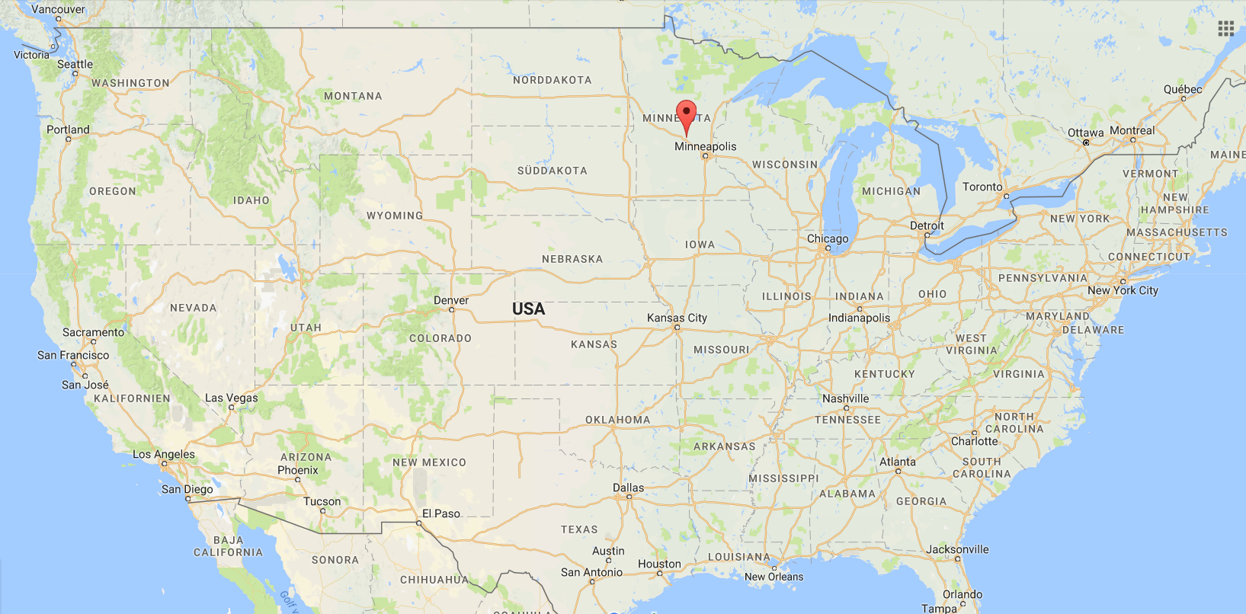
ABOUT TSV
Saint Cloud, Minnesota, USA
Textron Motors - Company Confidential – Do Not Duplicate or Distribute
5

Slide 6
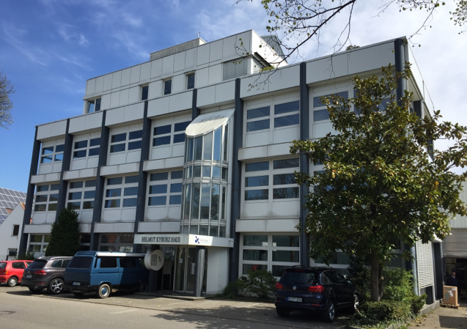
ABOUT TEXTRON MOTORS
Former Weber-Motor
15 years of engine manufacturing
German Engineering
Automotive Standards
Textron Motors - Company Confidential – Do Not Duplicate or Distribute
6

Slide 7
ABOUT TEXTRON MOTORS
Markdorf, Lake of Constance, Germany
Engineering
Prototype Construction
Testing/ Calibration
Quality
Sales
After Sales
Textron Motors - Company Confidential – Do Not Duplicate or Distribute
7

Slide 8
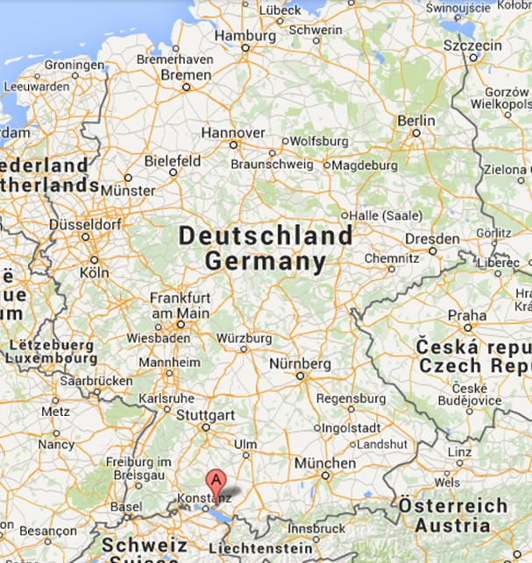
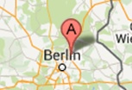
ABOUT TEXTRON MOTORS
  Markdorf, Lake of Constance, Germany
Textron Motors - Company Confidential – Do Not Duplicate or Distribute
8

Slide 9


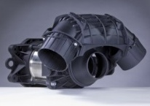
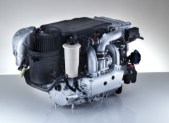
MPE 750/ 850 Marine: History
2003: SOP MPE 750 Marine for PWC
2008: MPE 750 for boat application / RIBs
2010: SOP composite jet propulsion system
2013: SOP MPE 850 Marine
Until end of 2016 16.500 Marine engines in the field
Textron Motors - Company Confidential – Do Not Duplicate or Distribute
9

Slide 10
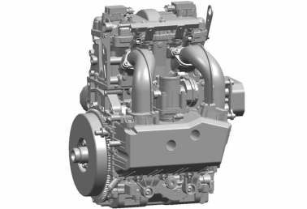
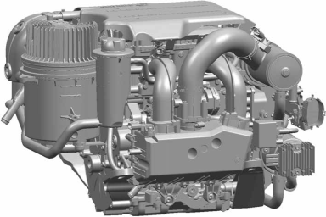
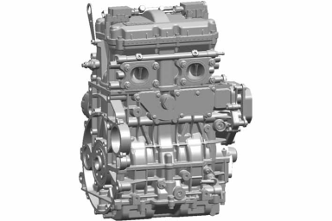

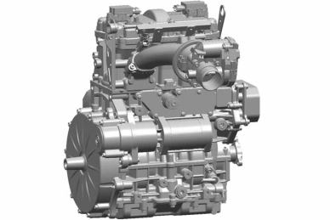
Topical Products
The Multi-Purpose-Engine MPE 850
appeals to different markets, requirements and applications
Off-Road
Marine
Automotive
Industrial
Snow Mobile
Dust and Dirt
Salt Water
Cost Effective
Durability
Low Temperatures
Textron Motors - Company Confidential – Do Not Duplicate or Distribute
10

